Slide 1




NFL Injury and Draft Success Prediction
Kelly He, Philip Rex Peters, Samuel Williamson, Tinkle Jain, Saswata Chakraborty

Slide 2

SAS
OBJECTIVE
Predict NFL player injuries
Predict draft success
Identify patterns and factors contributing to player injuries based on historical data
Develop predictive models to assess likelihood of injuries, mitigating risks and optimizing player management strategies.
Utilize NFL Combine metrics from a separate dataset to predict the likelihood of players being drafted
Assist teams with decision making by correlating metrics with player performance and career longevity

Slide 3
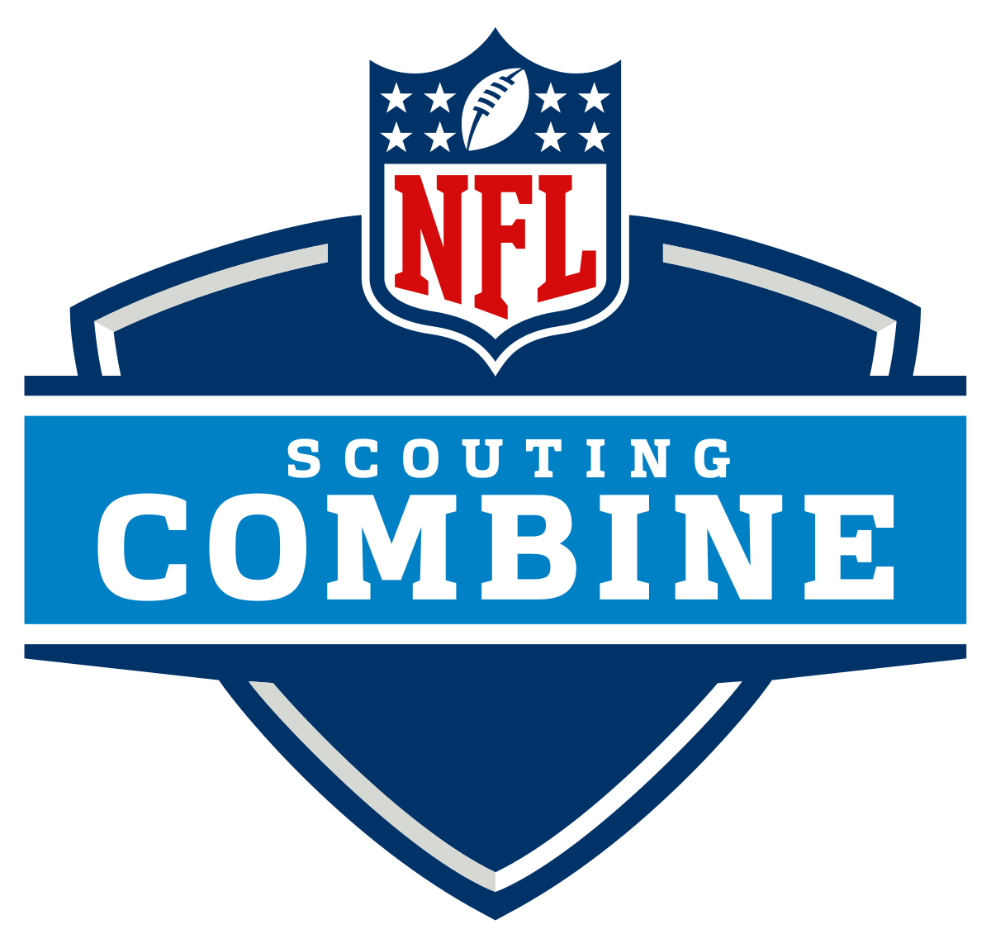

KELLY
INTRODUCTION
>1500 hits to the head in a single season
-Concussion/brain injury (life threatening)
Breslow, J. Frontline (2015, September 18)
Predicting likelihood of injuries can improve player safety!
Notes:
Using machine learning to predict likeliness of injury and draft to optimize performance

Slide 4
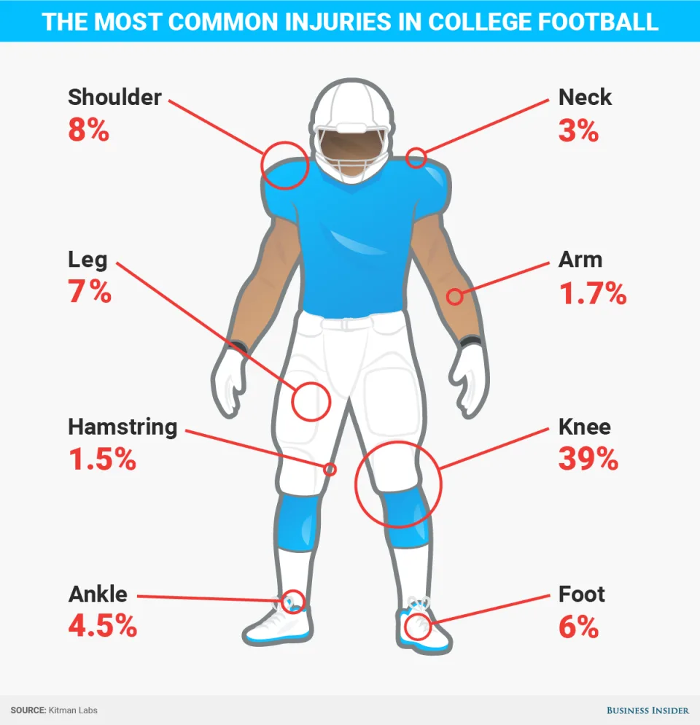
?
?
40-yard dash
Bench press
Vertical jump
Broad jump
20-yard shuttle
Three-cone drill
60-yard shuttle
?
?
Notes:
Players execute intensive drills to showcase their athletic ability testing speed, agility and reaction time. These activities include [ ] and create great risk for injury, whcih could hiinder the career of a prospective college athlete or jeapordize their health. To help minimize risk of injury, our team built a machine learning model to identify patterns and predict the severity of risk based on player stats. Doing so not only benefits the athlete in safety measures, but also contributes to greater chance at draft success.

Slide 5

KELLY
DATA SOURCES
01
02
03
Injury Record
PlayList
NFL Combine
105 injury records
100 unique players
Key columns: ‘PlayerKey’, ‘GameID’, ‘PlayKey’
28 PlayKey values missing
250 players
5,712 games
267,005 plays
Key columns: ‘PlayerKey’, ‘GameID’, ‘PlayKey’
3,476 unique players
Key columns: ‘Drafted’, ‘Player_Type’, ‘Position_Type’, ‘Age’, ‘School’
Notes:
We used three data sources from Kaggle. Mostly focuses on lower body injuries that occur.

Slide 6
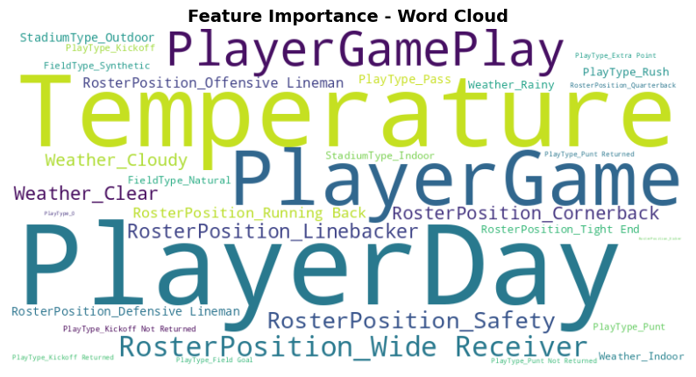
TINKLE
FACTORS LEADING TO INJURY
Notes:
Through our analysis, we identified nine critical features influencing injury risk:
Player position – Different positions face varying levels of physical impact.
Days since last game – Shorter recovery time can increase injury risk.
Game ID – Contextualizing injury occurrences by specific games.
Stadium type & Field type – Turf vs. grass surfaces impact injury frequency.
Temperature & Weather – Extreme conditions affect player safety.
Play type – Certain plays involve higher injury risks.
Player gameplay (# of plays in a game) – Higher workload increases fatigue and injury likelihood.

Slide 7
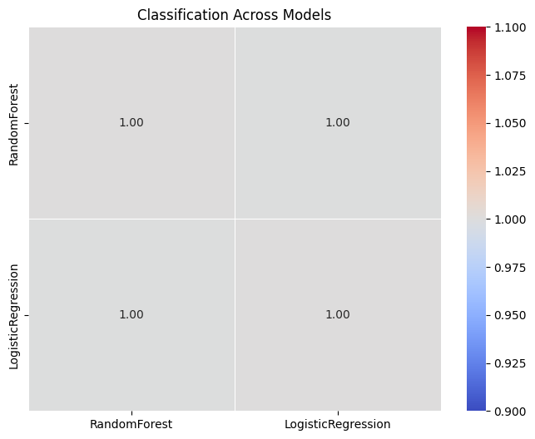
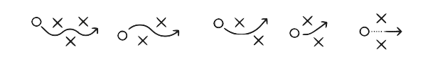
TINKLE
METHODOLOGIES
*Just for ref. yet to code
INJURY
Random Forest Model most effective ML model at predicting injury
Significant factors that contribute to injury
Rest between games
Temperature
# Plays in a single game
Notes:
For injury prediction, we tested Logistic Regression and Random Forest models. Among them, Random Forest proved to be the most effective in predicting injuries due to its ability to capture complex patterns in the data.
Our analysis highlighted three significant factors contributing to injuries:
Rest between games – Insufficient recovery time increases injury risk.
Temperature – Extreme weather conditions can impact player performance and safety.
Number of plays in a single game – Higher workload leads to fatigue, raising the likelihood of injuries.
By leveraging these insights, we can enhance player safety through better scheduling and workload management.

Slide 8
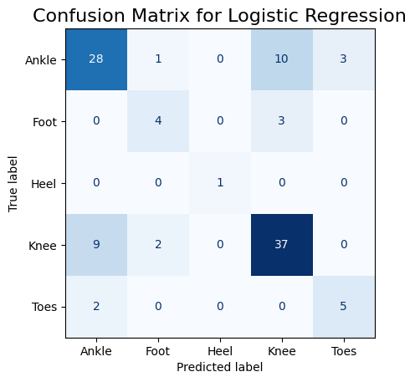
TINKLE
INJURY PREDICTION MODEL

Slide 9

PATTERNS AND FACTORS FOR DRAFT SUCCESS
REX
Predictive Features:
'Age'
'School'
'Height',
Weight'
'Sprint_40yd'
'Vertical_Jump',
'Bench_Press_Reps'
'Broad_Jump'
'Agility_3cone'
'Shuttle'
'BMI',
'Player_Type
'Position_Type'
'Position'
Outcome Variable:
‘Drafted’
‘School’
253 unique colleges
University of Alabama Count = 101
University of LSU Count = 95
Over 90 colleges with Count = 1
‘Bench_Press_Reps’
Max Value = 49
Min Value = 2
‘Sprint_40yd’
Max Value = 6.0 Seconds
Min Value = 4.22 Seconds

Slide 10
REX
METHODOLOGIES FOR
DRAFTING PREDICTION MODEL
Data Preprocessing
Cleaning
Missing values
Outliers
Feature Engineering
Selecting & removing columns
One-Hot Encoding
Get_dummies for non numerical data
Scaling
Normalize the values of features
Machine Learning
Model Selection
Model Training and Optimization
Data splitting
Model Tuning
Model Evaluation
Accuracy → Overall correctness
Precision & Recall → Important for imbalanced datasets
Explainability and Insights
SHAP (Feature Importance)

Slide 11
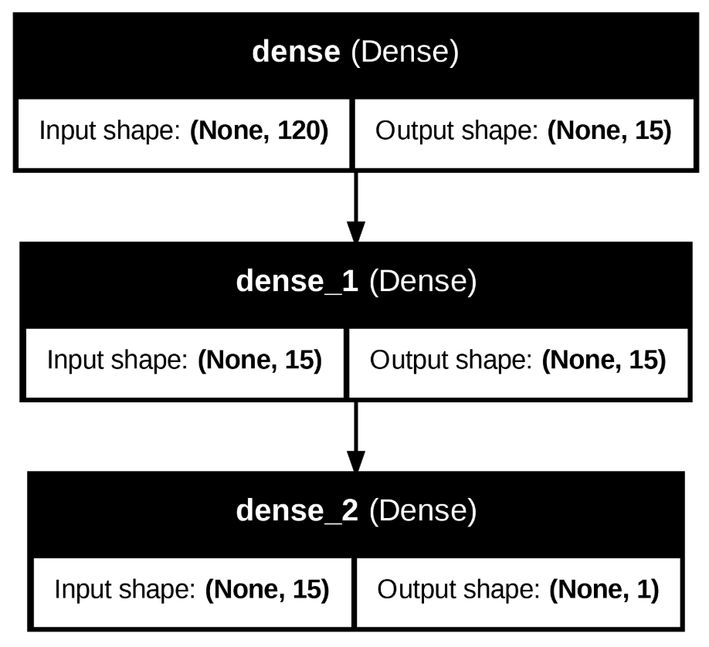
REX & SAM
DRAFTING PREDICTION MODEL

Slide 12
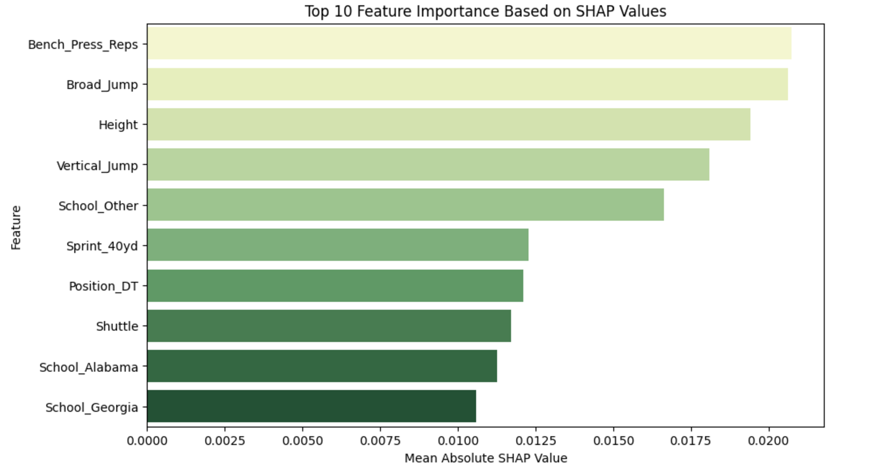
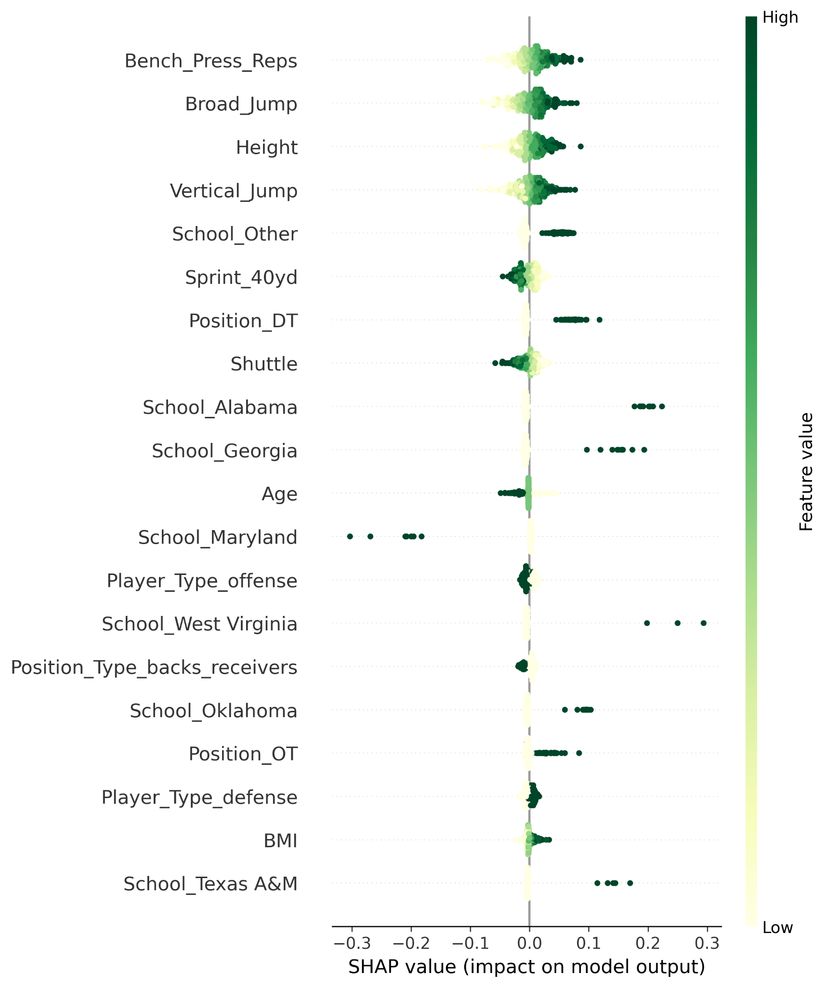
DRAFTING MODEL FEATURE ANALYSIS
REX

Slide 13

SAM
CONCLUSION
INJURY
Predicting when an injury is likely to occur is possible with machine learning models, which will help insure better player safety going forward
DRAFTING
Predicting when teams will draft players, just based on their combine statistics, is also possible with ML models
OVERALL
Machine learning will strongly contribute to the future of sports predictions going forward, with much more opportunity to explore what can be predicted

Slide 14
FURTHER RESEARCH

Slide 15
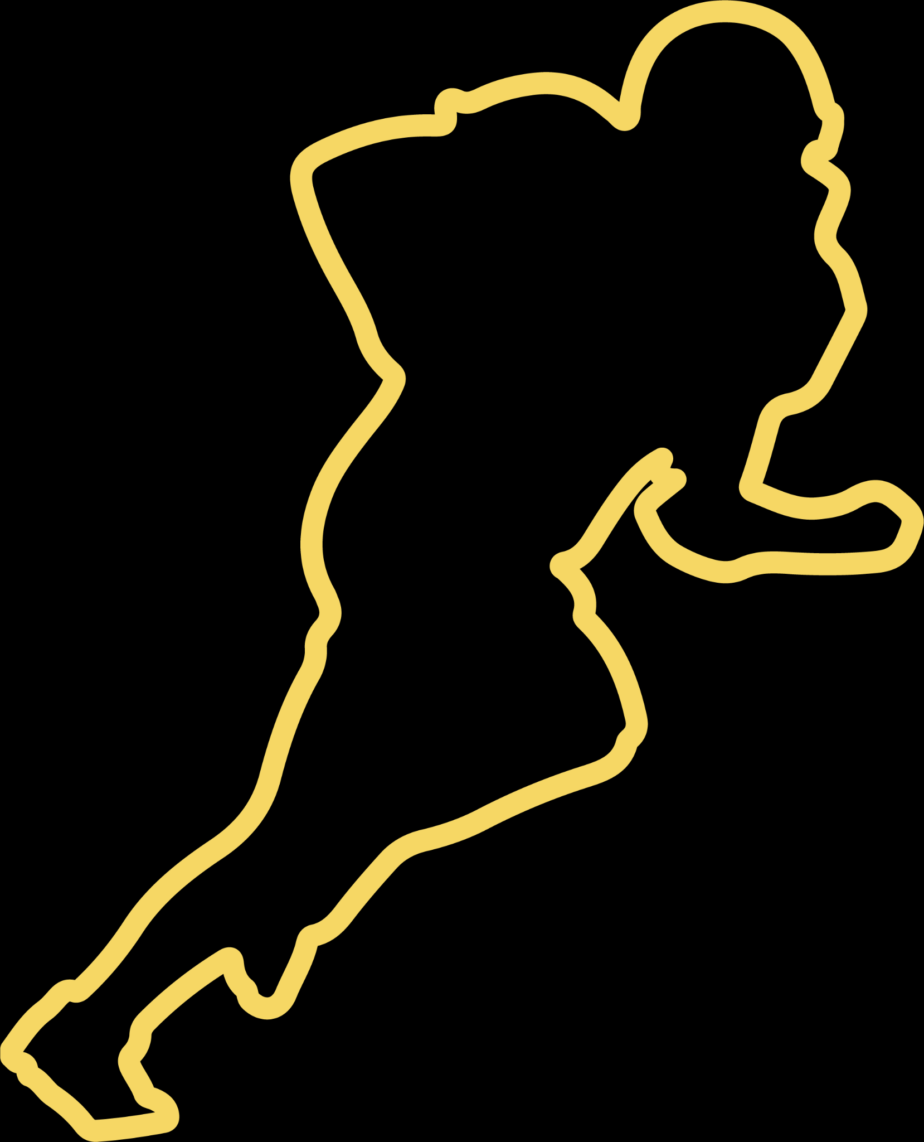
THANK YOU

